Slide 1
Решение
рациональных
неравенств
(задание 15 ЕГЭ)

Slide 2



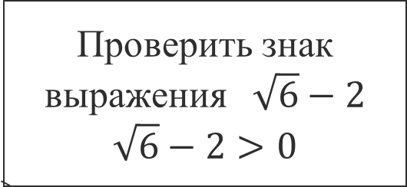
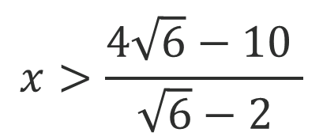
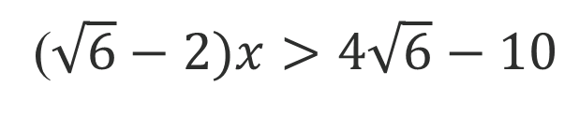

Задание 1. Линейное неравенство
$$x\sqrt{6}−2x+10>4\sqrt{6}$$
$$x\sqrt{6}−2x>4\sqrt{6}−10$$
($\sqrt{6}−2)x>4\sqrt{6}−10$
Проверить знак выражения$\sqrt{6}−2$
$$\sqrt{6}−2>0$$
$$x>\frac{4\sqrt{6}−10 }{\sqrt{6}−2}$$
Преобразуем дробь: $\frac{4\sqrt{6}−10 }{\sqrt{6}−2}=\frac{(4\sqrt{6}−10\text{)(}\sqrt{6}+2)}{(\sqrt{6}−2)(\sqrt{6}+2)}=\frac{4\sqrt{6}\sqrt{6}−10\sqrt{6}+8\sqrt{6}−20}{6−4}=\frac{24−2\sqrt{6}−20 }{2}=\frac{4−2\sqrt{6} }{2}=2−\sqrt{6}$
///////////////////////////////////////////////
$$2−\sqrt{6}$$
Ответ: ($2−\sqrt{6}$; +$∞$)

Slide 3


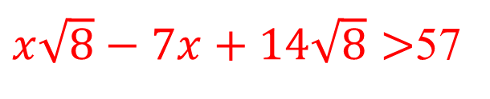
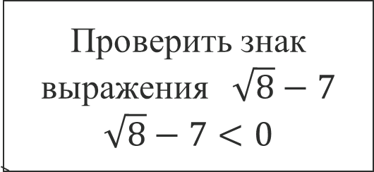
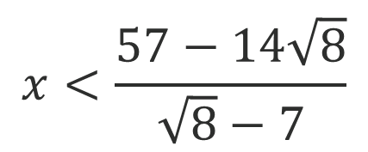
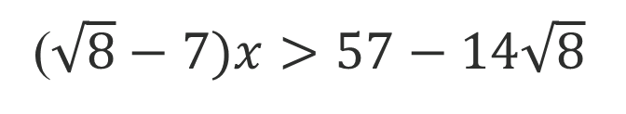
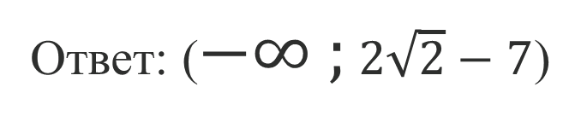
Задание 2. Линейное неравенство
$x\sqrt{8}−7x+14\sqrt{8}>$57
$$x\sqrt{8}−7x>57−14\sqrt{8}$$
($\sqrt{8}−7)x>57−14\sqrt{8}$
Проверить знак выражения$\sqrt{8}−7$
$$\sqrt{8}−7<0$$
$$x<\frac{57−14\sqrt{8}}{\sqrt{8}−7}$$
Преобразуем дробь: $\frac{57−14\sqrt{8} }{\sqrt{8}−7}=\frac{(57−14\sqrt{8} )(\sqrt{8}+7)}{(\sqrt{8}−7)(\sqrt{8}+7)}=\frac{57\sqrt{8}−14\sqrt{8}\sqrt{8}−14∙7\sqrt{8}+57∙7}{8−49}=\frac{−41\sqrt{8}+287 }{−41}=\sqrt{8}−7=2\sqrt{2}−7$
////////////////////////////////////
$$2\sqrt{2}−7$$
Ответ: ($−∞ ;2\sqrt{2}−7$)

Slide 4
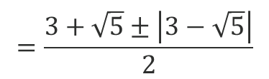

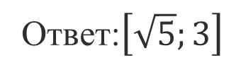
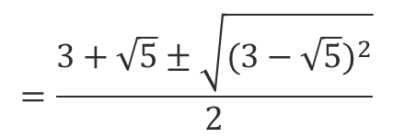
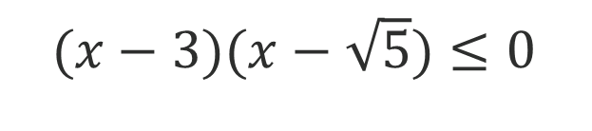



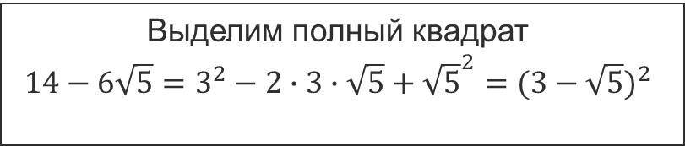
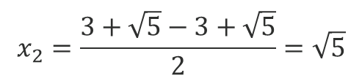
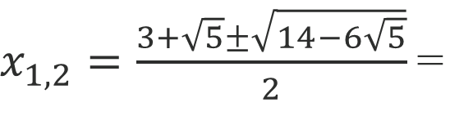

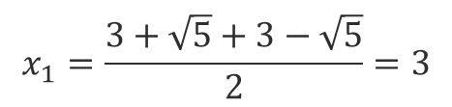
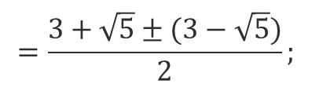

Задание 3. Квадратичное неравенство.
$$x^{2}−(3+\sqrt{5})x+3\sqrt{5}≤0$$
$$a=1 b=−\left(3+\sqrt{5}\right) c=3\sqrt{5}$$
$$D={(−\left(3+\sqrt{5}\right))}^{2}−4∙3\sqrt{5}=9+6\sqrt{5}+5−12\sqrt{5}=14−6\sqrt{5}$$
Выделим полный квадрат
$$14−6\sqrt{5}=3^{2}−2∙3∙\sqrt{5}+{\sqrt{5}}^{2}={(3−\sqrt{5})}^{2}$$
$$=\frac{3+\sqrt{5}±\sqrt{{(3−\sqrt{5})}^{2}}}{2}$$
$x_{1,2}=\frac{3+\sqrt{5}±\sqrt{14−6\sqrt{5}}}{2}$=
$$=\frac{3+\sqrt{5}±\left|3−\sqrt{5}\right|}{2}$$
$$=\frac{3+\sqrt{5}±(3−\sqrt{5})}{2};$$
$$x_{1}=\frac{3+\sqrt{5}+3−\sqrt{5}}{2}=3$$
$$x_{2}=\frac{3+\sqrt{5}−3+\sqrt{5}}{2}=\sqrt{5}$$
$(x−3)(x−\sqrt{5})$ $≤0$
$$+$$
$$−$$
$$+$$
/////////////////////////////////////////
$$\sqrt{5}$$
$$3$$
Ответ:$\left[\sqrt{5};3\right]$

Slide 5
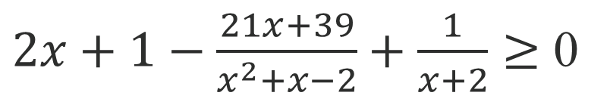
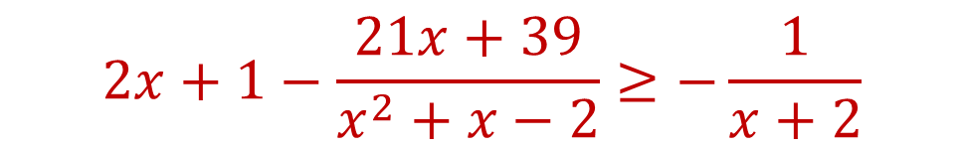
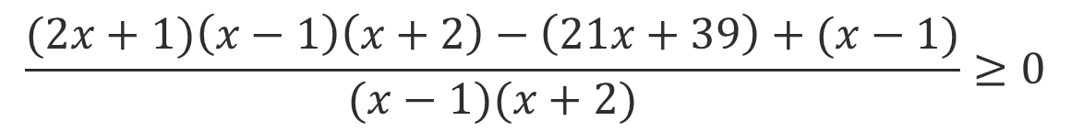
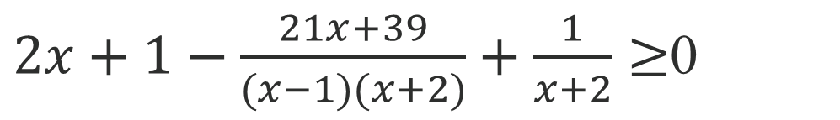
Дробно-рациональное неравенство.
Задание 4.
$$2x+1−\frac{21x+39}{x^{2}+x−2}≥−\frac{1}{x+2}$$
$2x+1−\frac{21x+39}{x^{2}+x−2}+\frac{1}{x+2}≥$ 0
$2x+1−\frac{21x+39}{(x−1)(x+2)}+\frac{1}{x+2}≥$0
$$\frac{(2x+1)\left(x−1\right)\left(x+2\right)−\left(21x+39\right)+(x−1)}{(x−1)(x+2)}≥0$$

Slide 6
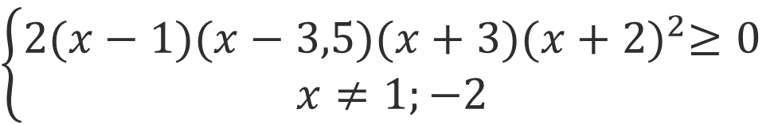


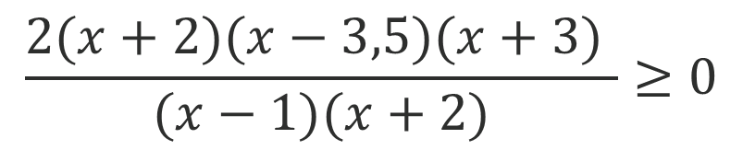

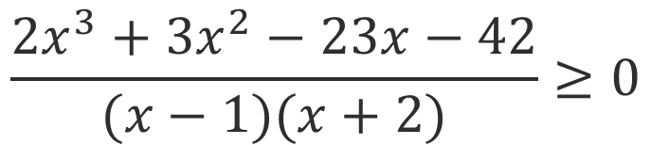







$$\frac{2x^{3}+3x^{2}−23x−42}{(x−1)(x+2)}≥0$$
$$2x^{3}+3x^{2}−23x−42=$$
2
$$(x+2)$$
$$(x−3,5)$$
($x+3)$
$$\frac{2(x+2)(x−3,5)(x+3) }{(x−1)(x+2)}≥0$$
$$\left\{\begin{aligned}2(x−1)(x−3,5)(x+3){(x+2)}^{2}≥0 \\ x≠1;−2\end{aligned}\right.$$
$$+$$
$$+$$
$$−$$
$$+$$
$$−$$
//////////////// //////////////// //////////////////////////
-3
-2
1
3,5
Ответ: $\left[−3;−2)∪(−2;1)∪\left[3,5; +∞)\right.\right.$

Slide 7
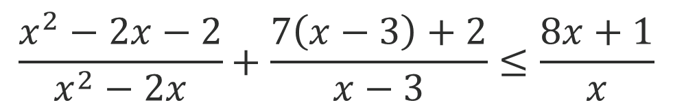
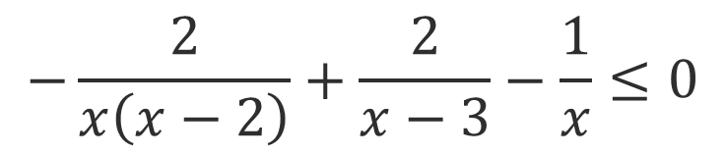
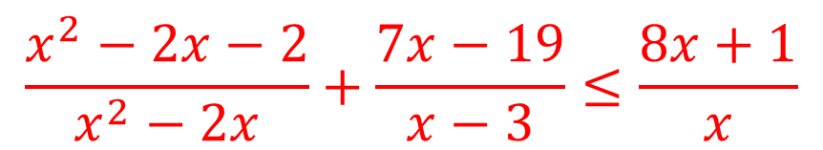
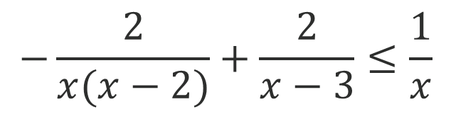
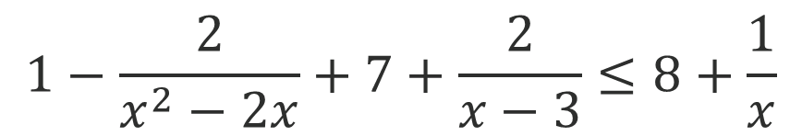
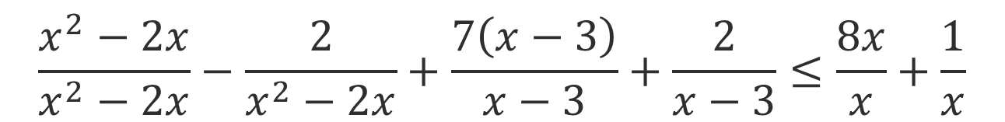
Задание 5. Дробно-рациональное неравенство.
$$\frac{x^{2}−2x−2}{x^{2}−2x}+\frac{7x−19}{x−3}≤\frac{8x+1}{x}$$
$$\frac{x^{2}−2x−2}{x^{2}−2x}+\frac{7\left(x−3\right)+2}{x−3}≤\frac{8x+1}{x}$$
$$\frac{x^{2}−2x}{x^{2}−2x}−\frac{2}{x^{2}−2x}+\frac{7\left(x−3\right)}{x−3}+\frac{2}{x−3}≤\frac{8x}{x}+\frac{1}{x}$$
$$1−\frac{2}{x^{2}−2x}+7+\frac{2}{x−3}≤8+\frac{1}{x}$$
$$−\frac{2}{x(x−2)}+\frac{2}{x−3}≤\frac{1}{x}$$
$$−\frac{2}{x\left(x−2\right)}+\frac{2}{x−3}−\frac{1}{x}≤0$$

Slide 8


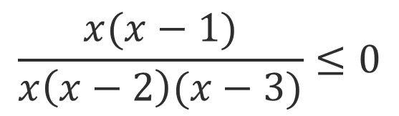


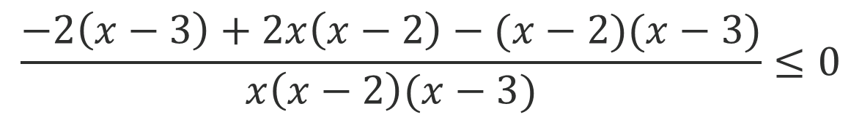



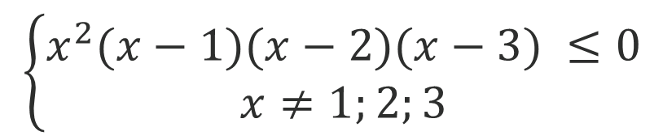


$$\frac{−2\left(x−3\right)+2x\left(x−2\right)−(x−2)(x−3)}{x\left(x−2\right)(x−3)}≤0$$
$$\frac{x(x−1)}{x\left(x−2\right)(x−3)}≤0$$
$$\left\{\begin{aligned}x^{2}(x−1)(x−2)(x−3) ≤0 \\ x≠1;2;3\end{aligned}\right.$$
$$−$$
$$−$$
$$+$$
$$−$$
$$+$$
/////////////////// /////////////////////////// ////////////////////////////
$$0$$
$$1$$
$$2$$
$$3$$
Ответ: $(−∞;0)∪(0;\left.1\right]∪(2;3)$

Slide 9
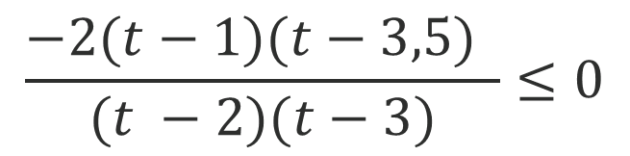


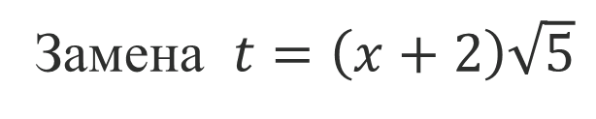
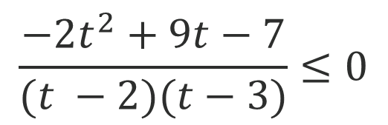


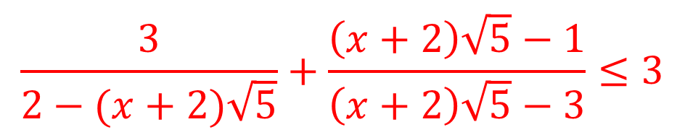

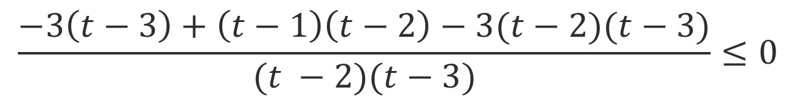

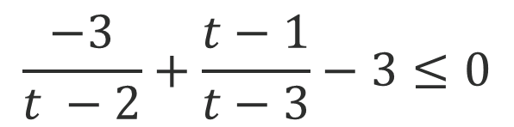


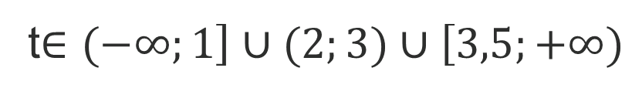
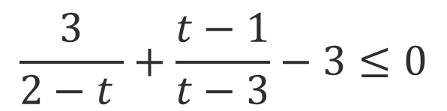
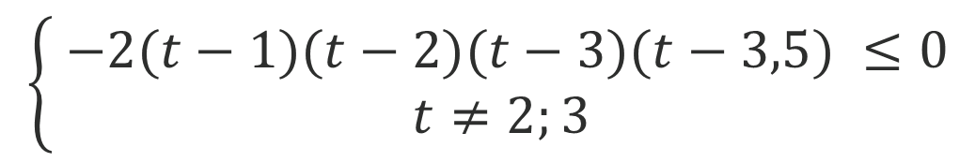

Задание 6. Дробно-рациональное неравенство.
$$\frac{3}{2−(x+2)\sqrt{5}}+\frac{\left(x+2\right)\sqrt{5}−1}{\left(x+2\right)\sqrt{5}−3}≤3$$
Замена $t=\left(x+2\right)\sqrt{5}$
$$\frac{3}{2−t }+\frac{t−1}{t−3}−3≤0$$
$$\frac{−3}{t −2}+\frac{t−1}{t−3}−3≤0$$
$$\frac{−3\left(t−3\right)+\left(t−1\right)\left(t−2\right)−3(t−2)(t−3)}{(t −2)(t−3)}≤0$$
$$\frac{−2t^{2}+9t−7}{(t −2)(t−3)}≤0$$
$$\left\{\begin{aligned} −2(t−1)(t−2)(t−3)(t−3,5) ≤0 \\ t≠2;3\end{aligned}\right.$$
$$\frac{−2{(t−1)(t−3,5) }^{ }}{(t −2)(t−3)}≤0$$
$$−$$
$$+$$
$$−$$
$$+$$
$$−$$
///////////////////// //////////////////////// ///////////////
$$1$$
$$2$$
$$3$$
$$3,5$$
t$∈(−∞;\left.1\right]∪(2;3)∪\left[3,5;+∞)\right.$

Slide 10
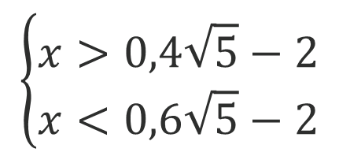

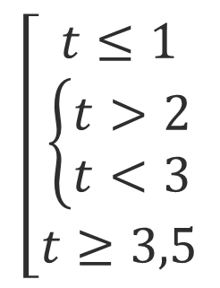


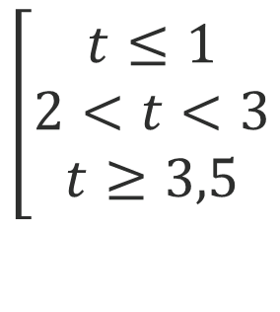
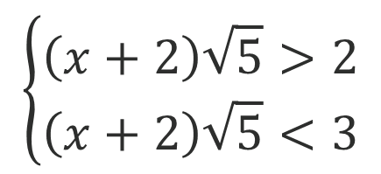



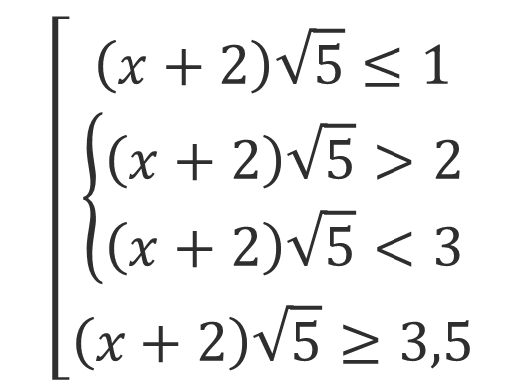


$$\left[\begin{aligned}t≤1 \\ 2<t<3 \\ t≥3,5\end{aligned}\right.$$
$$\left[\begin{aligned}t≤1 \\ \left\{\begin{aligned}t>2 \\ t<3\end{aligned}\right. \\ t≥3,5\end{aligned}\right.$$
$$\left[\begin{aligned}\left(x+2\right)\sqrt{5}≤1 \\ \left\{\begin{aligned}\left(x+2\right)\sqrt{5}>2 \\ \left(x+2\right)\sqrt{5}<3\end{aligned}\right. \\ \left(x+2\right)\sqrt{5}≥3,5\end{aligned}\right.$$
$$\left(x+2\right)\sqrt{5}≤1$$
$$\left\{\begin{aligned}\left(x+2\right)\sqrt{5}>2 \\ \left(x+2\right)\sqrt{5}<3\end{aligned}\right.$$
$$\left(x+2\right)\sqrt{5}≥3,5$$
$$x≤0,2\sqrt{5}−2$$
$$x≥0,7\sqrt{5}−2$$
$$\left\{\begin{aligned}x>0,4\sqrt{5}−2 \\ x<0,6\sqrt{5}−2\end{aligned}\right.$$
//////////////////// ////////////////////// ///////////////
$$0,2\sqrt{5}−2$$
$$0,4\sqrt{5}−2$$
$$0,6\sqrt{5}−2$$
$$0,7\sqrt{5}−2$$
Ответ:$(−∞;\left.0,2\sqrt{5}−2 \right]∪(0,4\sqrt{5}−2;0,6\sqrt{5}−2)∪\left[0,7\sqrt{5}−2 ;+∞)\right.$

Slide 11
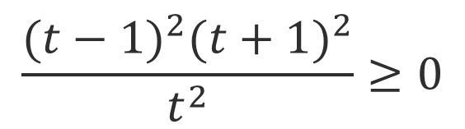

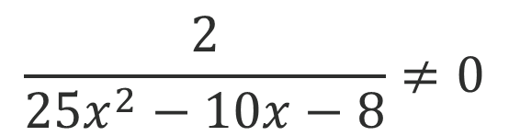
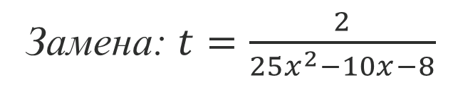















Задание 7. Дробно-
рациональное неравенство.
$${\text{(}\frac{2}{25x^{2}−10x−8}+\frac{25x^{2}−10x−8}{2})}^{2}≥4$$
ОДЗ: $25x^{2}−10x−8≠0$
$x≠−\frac{2}{5};\frac{4}{5}$
$$\left\{\begin{aligned}t^{2}{(t−1)}^{2}{(t+1)}^{2} ≥0 \\ t≠0\end{aligned}\right.$$
Замена: $t=\frac{2}{25x^{2}−10x−8}$
$${(t+\frac{1}{t})}^{2}−4≥0$$
$$+$$
$$−1$$
$$+$$
$$0$$
$$+$$
$$1$$
$$+$$
/////////////////////////////////////////////////////////////////////////////////////
$$(t+\frac{1}{t}−2)(t+\frac{1}{t}+2)≥0$$
$$=>t−любое, t≠0$$
$$\frac{2}{25x^{2}−10x−8}≠0$$
$$\frac{2}{(x+\frac{2}{5})(x−\frac{4}{5})}≠0$$
$$\frac{t^{2}−2t+1}{t}∙\frac{t^{2}+2t+1}{t}≥0$$
$$\frac{{(t−1)}^{2}{(t+1)}^{2}}{t^{2}}≥0$$
Ответ:$(−∞;−0,4)∪(−0,4;0,8)∪(0,8;+∞)$

Slide 12





Для самостоятельного решения:
$1. (25x^{2}−4)(3x^{2}−2x−5)≥$ $(25x^{2}−4)(2x^{2}−2x−5$)
2. $x^{2}+\left(1−\sqrt{10}\right)x−\sqrt{10}≤0$
3.$\frac{1}{x−2}+\frac{1}{3−x}≤5$
$$4. \frac{20x^{2}−32x+3}{3x^{2}+7x+2}≤0$$
5. $\frac{x^{2}−5x−6}{x^{2}−1}≤\frac{x−9}{x−1}+\frac{2}{x−3}$
6. $\frac{4x^{4}−4x^{3}+x^{2}}{−2x^{2}+5x−2}+\frac{2x^{3}−7x^{2}+5x+1}{x−2}≤0$

